Slide 1
Diamond Price Prediction Project
Project aim.
Project Stages:
Data Analysis
Data Visualization
Preprocessing
Select, Train and Evaluate Models
Aseel Amiri
Leen Mohammad
Reem Jbily
Mentor: Mohammad Essam

Slide 2
Diamond Price Prediction Project
Data set description:
There are two files:
Train set: (43152, 11)
Test set: (10788, 10)
Data contains numerical and categorical values.
Aseel Amiri
Leen Mohammad
Reem Jbily
Mentor: Mohammad Essam

Slide 3
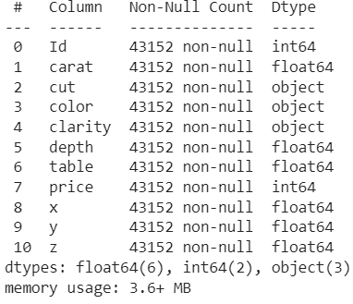
Diamond Price Prediction Project
Train set columns:
Aseel Amiri
Leen Mohammad
Reem Jbily
Mentor: Mohammad I Essam

Slide 4
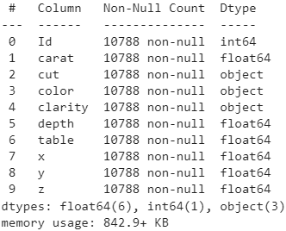
Diamond Price Prediction Project
Test set columns:
Aseel Amiri
Leen Mohammad
Reem Jbily
Mentor: Mohammad Essam

Slide 5
Diamond Price Prediction Project
1-Data Analysis:
Using panadas and NumPy to get insights on data.
We found:
No null values.
Strong correlation between price column and the following columns:
Carat, cut, color, clarity, x, y, z.
3. x, y and z columns contain zero values.
Aseel Amiri
Leen Mohammad
Reem Jbily
Mentor: Mohammad Essam

Slide 6
Diamond Price Prediction Project
2-Data Visualization:
Using panadas, matplotlib and seaborn to get insights on data.
We found:
Outliers in columns using boxplots.
Exponential relation between carat and diamond price using scatter plot.
Correlation between different columns using heatmap.
Aseel Amiri
Leen Mohammad
Reem Jbily
Mentor: Mohammad Essam

Slide 7
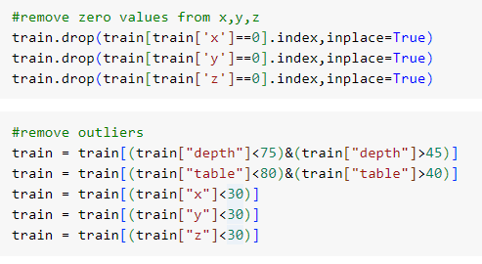
Diamond Price Prediction Project
3-Data Preprocessing:
Remove zero values from x, y, and z columns.
Remove outliers from x, y and z columns.
Aseel Amiri
Leen Mohammad
Reem Jbily
Mentor: Mohammad Essam

Slide 8
Diamond Price Prediction Project
4-Train, Test and Evaluate ML Models:
Column transformations:
For carat, depth, table, x, y and z columns:
SimpleImputer (starategy=‘mediam’).
CombinedAttributesAdder().
StandardScaler().
For cut, color and clarity columns:
OrdinalEncoder()
StandardScaler().
Aseel Amiri
Leen Mohammad
Reem Jbily
Mentor: Mohammad Essam

Slide 9
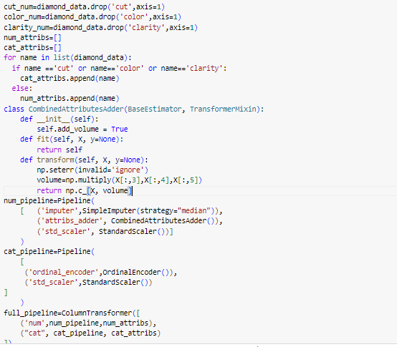
Diamond Price Prediction Project
Aseel Amiri
Leen Mohammad
Reem Jbily
Mentor: Mohammad Essam

Slide 10
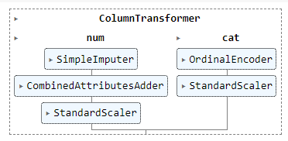
Diamond Price Prediction Project
The pipeline output:
Aseel Amiri
Leen Mohammad
Reem Jbily
Mentor: Mohammad Essam

Slide 11
Diamond Price Prediction Project
4-Train, Test and Evaluate ML Models:
Models selected:
Linear regression.
Lasso Regression.
Decision Tree.
Random Forest.
XGBoost Regressor.
Voting Regression.
Aseel Amiri
Leen Mohammad
Reem Jbily
Mentor: Mohammad Essam

Slide 12
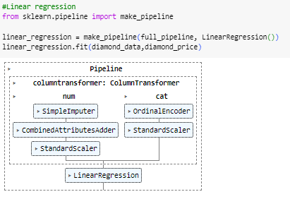
Diamond Price Prediction Project
Training Linear Regression:
Aseel Amiri
Leen Mohammad
Reem Jbily
Mentor: Mohammad Essam

Slide 13
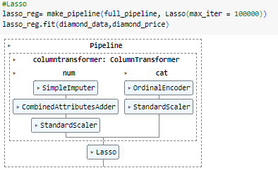
Diamond Price Prediction Project
Training Lasso Regression:
Aseel Amiri
Leen Mohammad
Reem Jbily
Mentor: Mohammad Essam

Slide 14
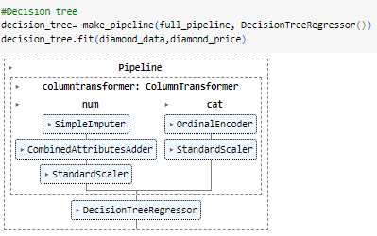
Diamond Price Prediction Project
Training Decision Tree:
Aseel Amiri
Leen Mohammad
Reem Jbily
Mentor: Mohammad Essam

Slide 15
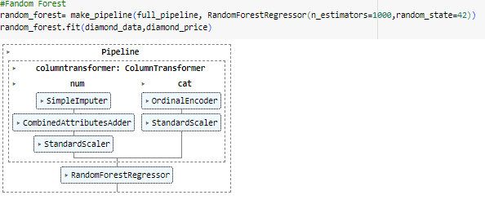
Diamond Price Prediction Project
Training Random Forest:
Aseel Amiri
Leen Mohammad
Reem Jbily
Mentor: Mohammad Essam

Slide 16
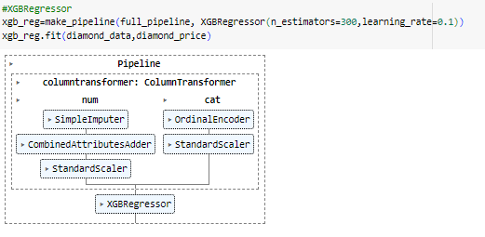
Diamond Price Prediction Project
Training XGBoost:
Aseel Amiri
Leen Mohammad
Reem Jbily
Mentor: Mohammad Essam

Slide 17
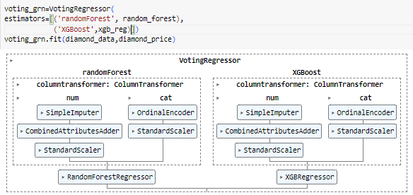
Diamond Price Prediction Project
Training Voting Regressor:
Aseel Amiri
Leen Mohammad
Reem Jbily
Mentor: Mohammad Essam

Slide 18
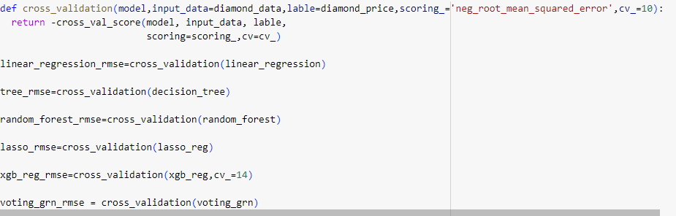
Diamond Price Prediction Project
Evaluating using cross validation:
Aseel Amiri
Leen Mohammad
Reem Jbily
Mentor: Mohammad Essam

Slide 19
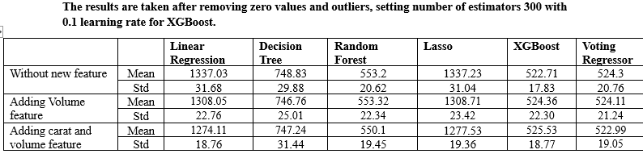
Diamond Price Prediction Project
Results:
Aseel Amiri
Leen Mohammad
Reem Jbily
Mentor: Mohammad Essam

Slide 20
Diamond Price Prediction Project
Conclusion:
The best result was using voting regressor with random forest (n_estimators=1000, random_state=42)
And XGBoost (n_estimators=300, lr= 0.1) with just adding volume feature.
Aseel Amiri
Leen Mohammad
Reem Jbily
Mentor: Mohammad Essam

